Slide 1
Machine Learning Discussing through available diagrams
to Adi Pancoro¹ and Udjianna Sekteria Pasaribu² from Sparisoma Viridi³
¹Genetics and Molecular Biotechnology Expertise Group, School of Life Sciences & Technology
²Statistics Research Group, Faculty of Mathematics and Natural Sciences
³Nuclear Physics and Biophysics Research Division, Faculty of Mathematics and Natural Sciences
¹⁻³Institut Teknologi Bandung, Bandung 40132, Indonesia
20230410-v3| https://doi.org/10.5281/zenodo.7816244

Slide 2
Outline
Artificial Intelligence 3
Machine Learning 7
Types 15
Algorithms 18
Applications 29
Architectures 33

Slide 3
Artificial Intelligence

Slide 4
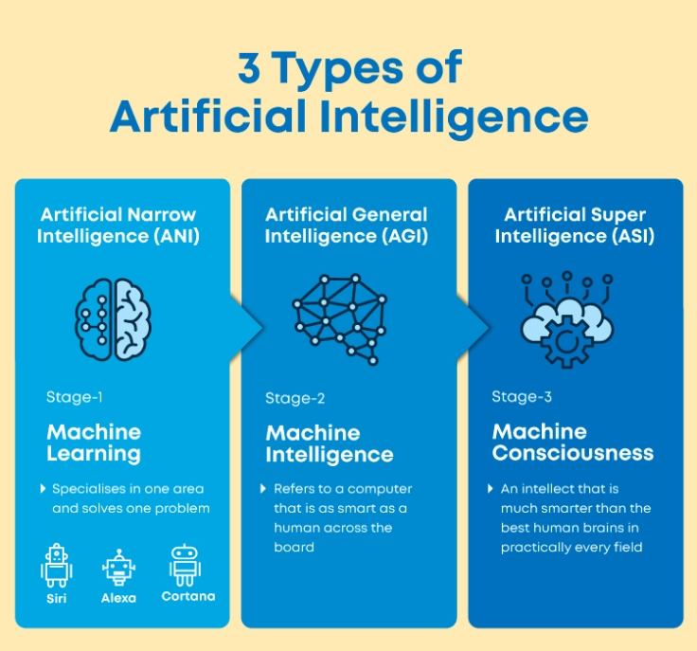
Great Learning Team, “What is Artificial Intelligence in 2023? Types, Trends, and Future of it?”, 7 Mar 2023, url https://www.mygreatlearning.com/blog/what-is-artificial-intelligence/ [20230411].

Slide 5
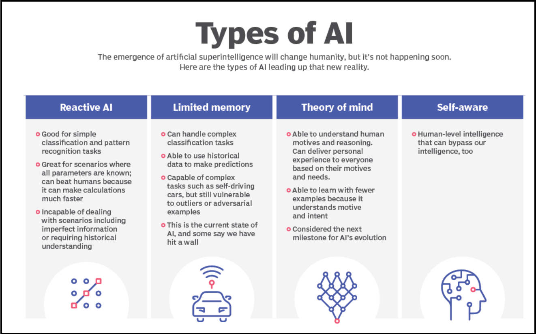
-, “4 Types of Artificial Intelligence”, Huawei, 20 Jun 2022, url https://forum.huawei.com/enterprise/en/4-types-of-artificial-intelligence/thread/891503-891 [20230411].

Slide 6
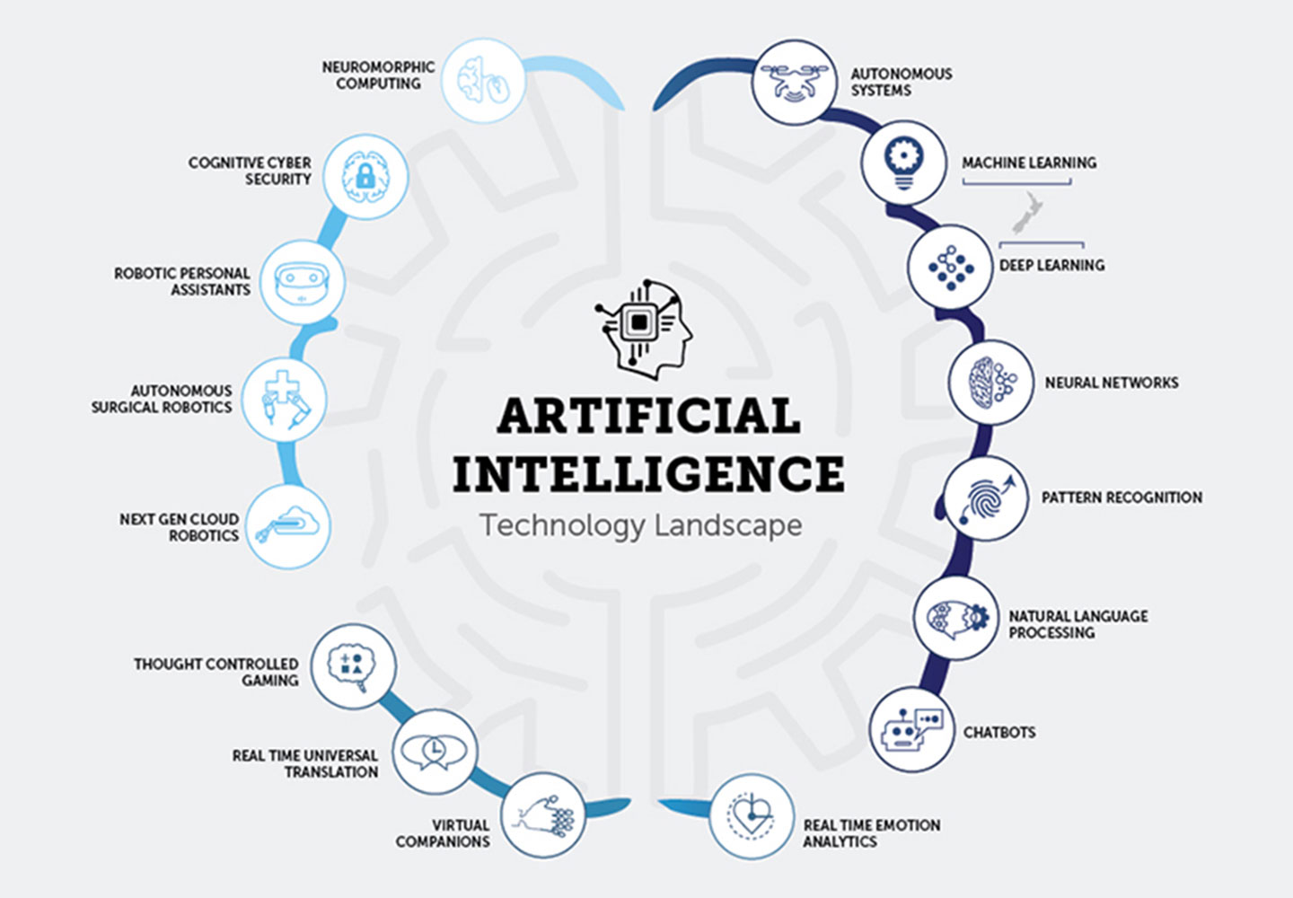
Abhishek Saraf, “Government steps to promote upskilling or reskilling of Artificial Intelligence”, Toppernotes, 31 Mar 2022, url https://web.toppersnotes.com/current-affairs/blog/government-steps-to-promote-upskilling-or-reskilling-of-artificial-intelligence-Bog9 [20230411].

Slide 7
Machine Learning

Slide 8
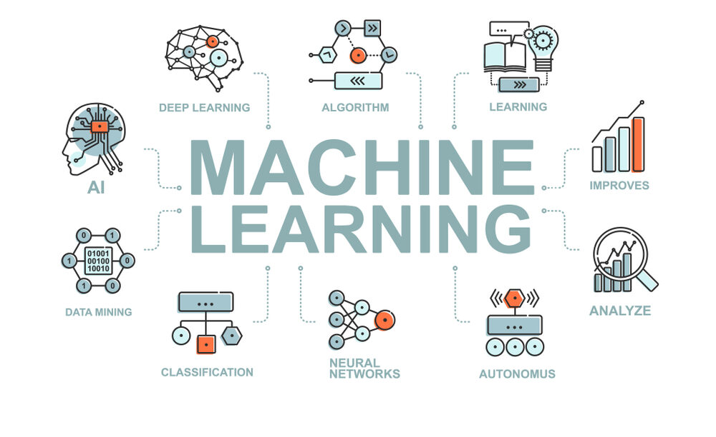
CCR, “An Introduction to Machine Learning, Its Importance, Types, and Applications”, FORE School of Management, New Delhi, 31 Aug 2022, url https://www.fsm.ac.in/blog/an-introduction-to-machine-learning-its-importance-types-and-applications/ [20230410].

Slide 9
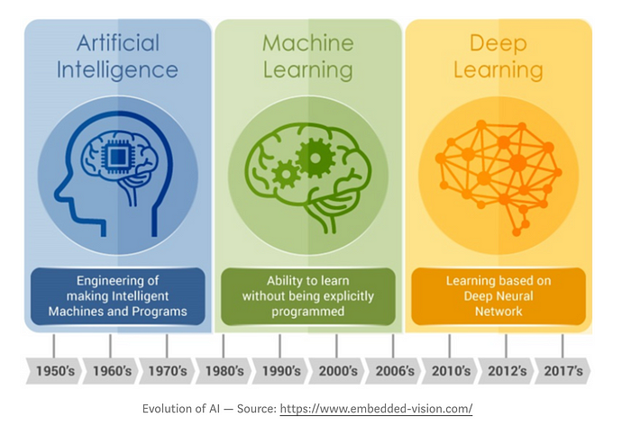
Vikita Padaliya, “Difference between AI, ML and DL”, Medium, 25 Sep 2019, url https://medium.com/decoding-artificial-intelligence/p-f5274d8db2 [20230411].

Slide 10
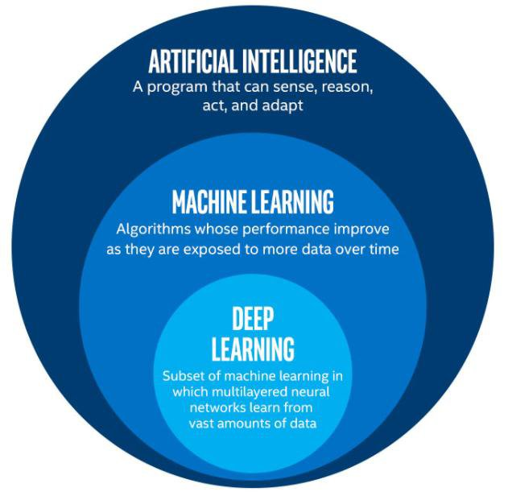
Rohini G. Khalkar, Adarsh Singh Dikhit, Anirudh Goel, Manisha Gupta, “Handwritten Text Recognition using Deep Learning (CNN & RNN)”, IARJSET 8(6):870-881, Jun 2021, url http://dx.doi.org/10.17148/IARJSET.2021.86148.

Slide 11
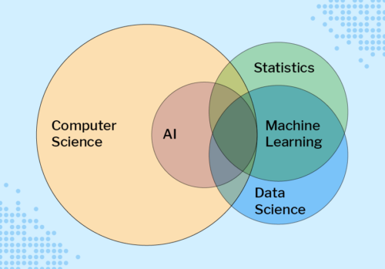
Sue Sentance, “Educating Young People in AI, Machine Learning, and Data Science: New Seminar Series”, Noise, 27 Jul 2021, url https://noise.getoto.net/2021/07/29/educating-young-people-in-ai-machine-learning-and-data-science-new-seminar-series/ [20230410].

Slide 12
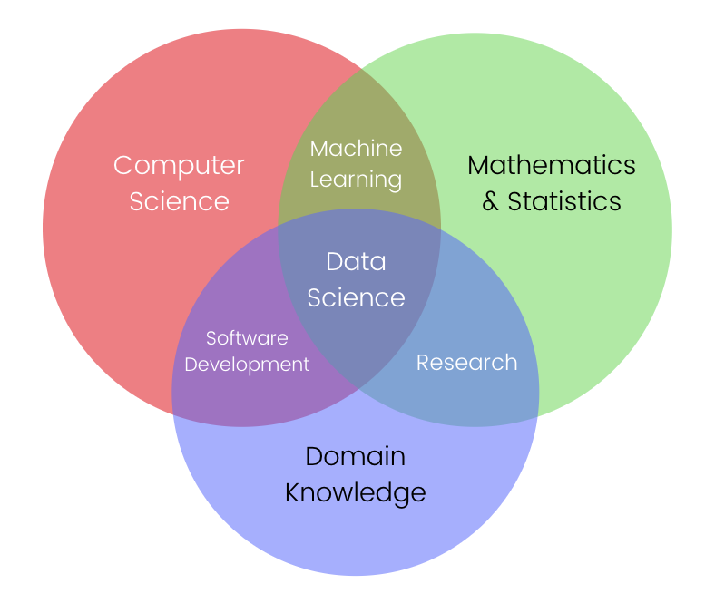
Jon-Ting, Coursera, GitHub, url https://www.meal2home.top/ProductDetail.aspx?iid=380751683&pr=39.88 [20230410].

Slide 13
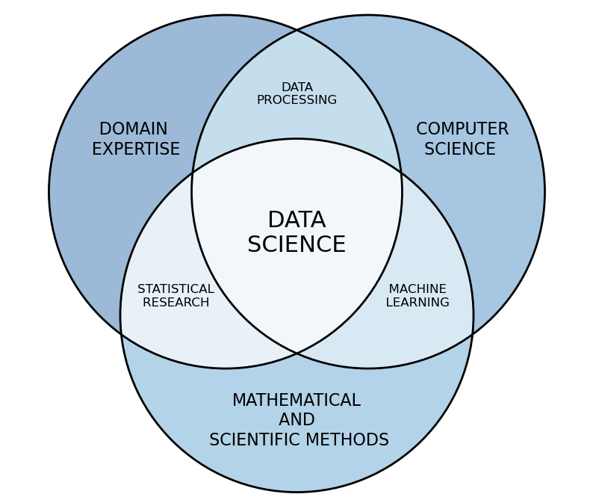
Rob Pascoe, “Data science”, Data Cymru, url https://www.data.cymru/data-science [20230410].

Slide 14
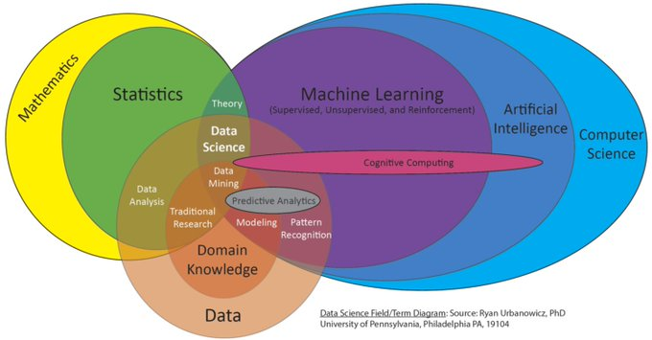
Ryan Urbanowicz, “New proposed field/term Venn diagram for an upcoming talk”, Twitter, 15 Jun 2018, url https://twitter.com/DocUrbs/status/1007375834347376642 [20230410].

Slide 15
Types

Slide 16
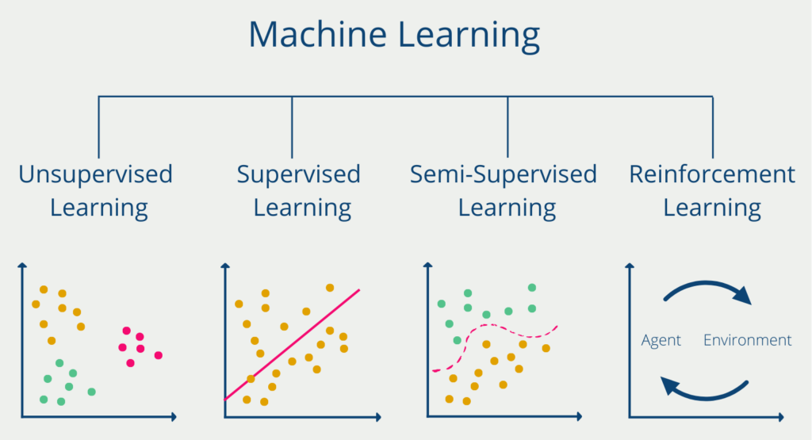
-, “Reinforcement Learning: Bestärkendes Lernen erklärt!”, Data Base Camp, 26 Jan 2022, url https://databasecamp.de/ki/reinforcement-learning [20230411].

Slide 17
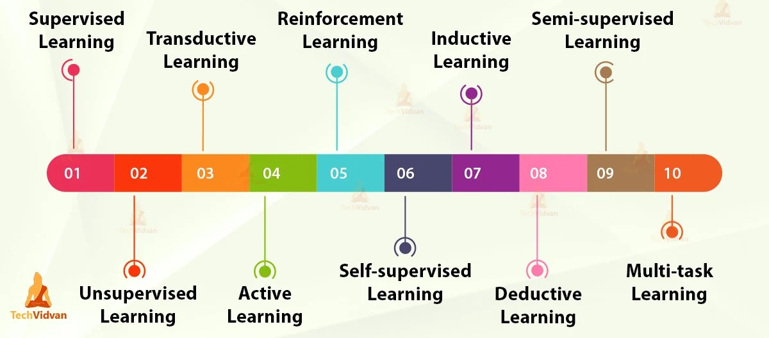
There is also another way for types of ML
TechVidvan Team, “Types of Machine Learning – Supervised, Unsupervised, Reinforcement”, Simplilearn, 10 Mar 2021, url https://techvidvan.com/tutorials/types-of-machine-learning/ [20230411].

Slide 18
Algorithms

Slide 19
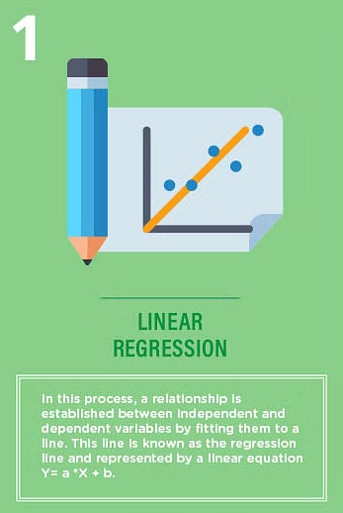
Simon Tavasoli, “Top 10 Machine Learning Algorithms For Beginners: Supervised, and More”, Simplilearn, 30 Mar 2023, url https://www.simplilearn.com/10-algorithms-machine-learning-engineers-need-to-know-article [20230410].

Slide 20
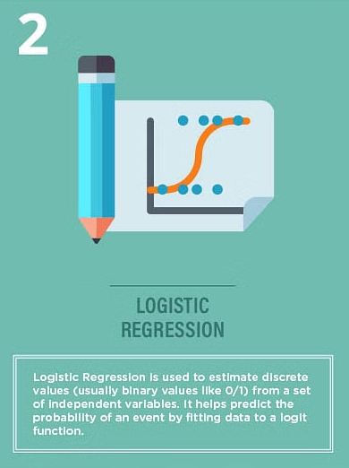
Simon Tavasoli, “Top 10 Machine Learning Algorithms For Beginners: Supervised, and More”, Simplilearn, 30 Mar 2023, url https://www.simplilearn.com/10-algorithms-machine-learning-engineers-need-to-know-article [20230410].

Slide 21
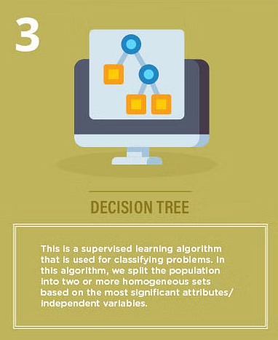
Simon Tavasoli, “Top 10 Machine Learning Algorithms For Beginners: Supervised, and More”, Simplilearn, 30 Mar 2023, url https://www.simplilearn.com/10-algorithms-machine-learning-engineers-need-to-know-article [20230410].

Slide 22
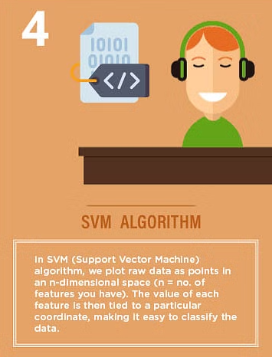
Simon Tavasoli, “Top 10 Machine Learning Algorithms For Beginners: Supervised, and More”, Simplilearn, 30 Mar 2023, url https://www.simplilearn.com/10-algorithms-machine-learning-engineers-need-to-know-article [20230410].

Slide 23
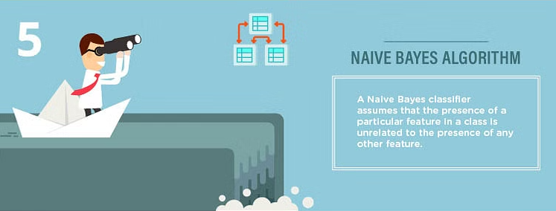
Simon Tavasoli, “Top 10 Machine Learning Algorithms For Beginners: Supervised, and More”, Simplilearn, 30 Mar 2023, url https://www.simplilearn.com/10-algorithms-machine-learning-engineers-need-to-know-article [20230410].

Slide 24
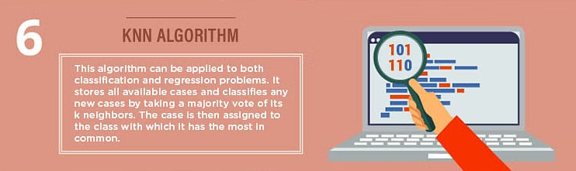
Simon Tavasoli, “Top 10 Machine Learning Algorithms For Beginners: Supervised, and More”, Simplilearn, 30 Mar 2023, url https://www.simplilearn.com/10-algorithms-machine-learning-engineers-need-to-know-article [20230410].

Slide 25
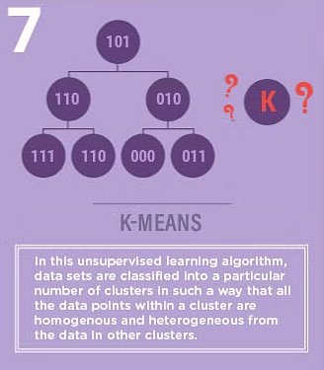
Simon Tavasoli, “Top 10 Machine Learning Algorithms For Beginners: Supervised, and More”, Simplilearn, 30 Mar 2023, url https://www.simplilearn.com/10-algorithms-machine-learning-engineers-need-to-know-article [20230410].

Slide 26
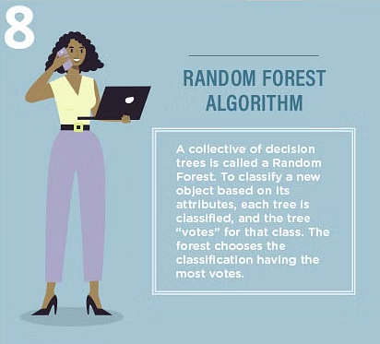
Simon Tavasoli, “Top 10 Machine Learning Algorithms For Beginners: Supervised, and More”, Simplilearn, 30 Mar 2023, url https://www.simplilearn.com/10-algorithms-machine-learning-engineers-need-to-know-article [20230410].

Slide 27
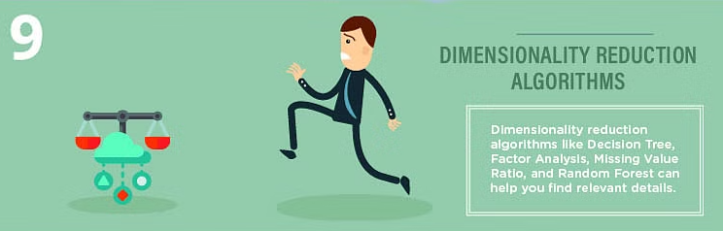
Simon Tavasoli, “Top 10 Machine Learning Algorithms For Beginners: Supervised, and More”, Simplilearn, 30 Mar 2023, url https://www.simplilearn.com/10-algorithms-machine-learning-engineers-need-to-know-article [20230410].

Slide 28
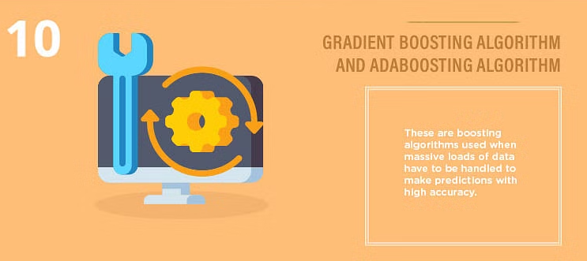
Simon Tavasoli, “Top 10 Machine Learning Algorithms For Beginners: Supervised, and More”, Simplilearn, 30 Mar 2023, url https://www.simplilearn.com/10-algorithms-machine-learning-engineers-need-to-know-article [20230410].

Slide 29
Applications

Slide 30
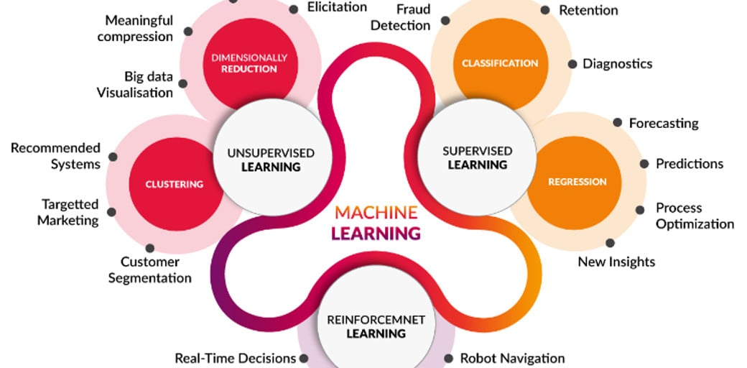
Mohaiminul Islam, “Machine Learning”, Kaggle, 6 Nov 2020, url https://www.kaggle.com/getting-started/195629 [20230411].

Slide 31
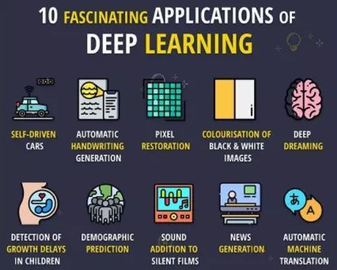
-, “Top Fascinating Application of Deep Learning”, Digital Leaders, 11 Oct 2020, url https://glweb.eu/blog/digital-transformation/155 [20230411].

Slide 32
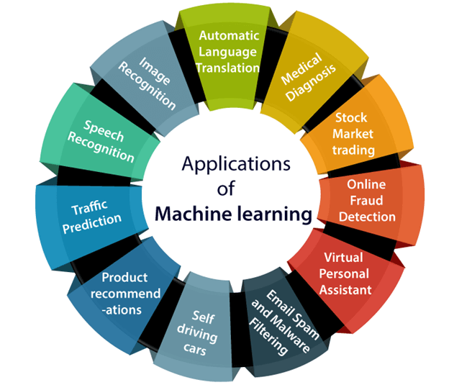
-, “Applications of Machine learning”, JavaTpoint, url https://www.javatpoint.com/applications-of-machine-learning [20230411].

Slide 33
Architectures

Slide 34
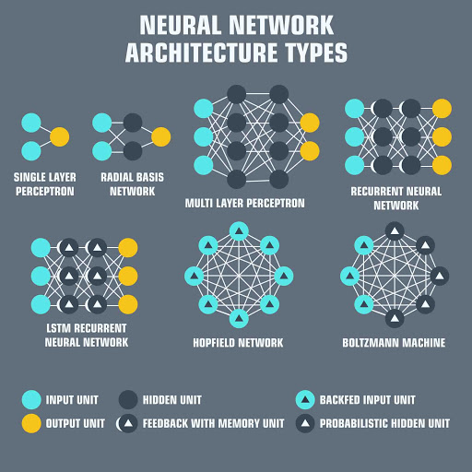
Mohaiminul Islam, “Machine Learning”, Kaggle, 6 Nov 2020, url https://www.kaggle.com/getting-started/195629 [20230411].

Slide 35
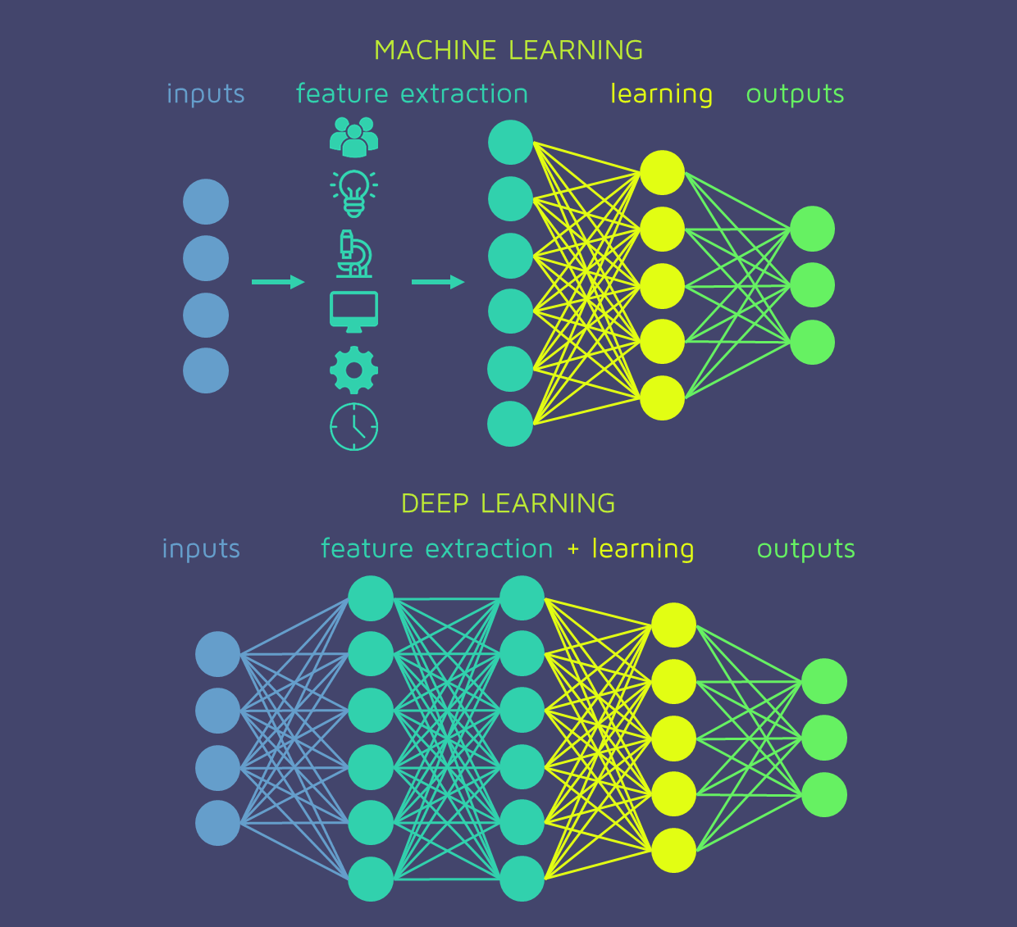
Mohaiminul Islam, “Machine Learning”, Kaggle, 6 Nov 2020, url https://www.kaggle.com/getting-started/195629 [20230411].

Slide 36
Mohaiminul Islam, “Machine Learning”, Kaggle, 6 Nov 2020, url https://www.kaggle.com/getting-started/195629 [20230411].

Slide 37

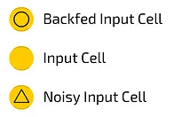
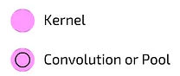
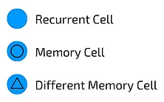
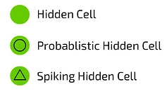
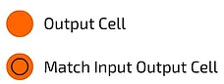
Andrew Tch, “The mostly complete chart of Neural Networks, explained”, Towards Data Science, 4 Aug 2017, url https://towardsdatascience.com/p-3fb6f2367464 [20230411].

Slide 38
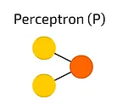
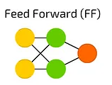
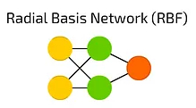
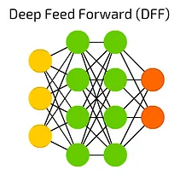
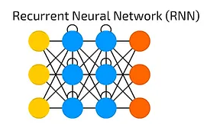
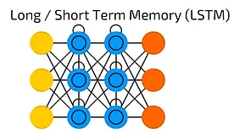
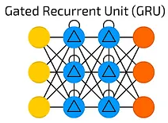
Andrew Tch, “The mostly complete chart of Neural Networks, explained”, Towards Data Science, 4 Aug 2017, url https://towardsdatascience.com/p-3fb6f2367464 [20230411].

Slide 39
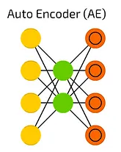
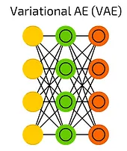
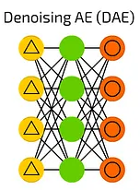
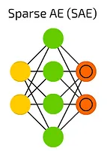
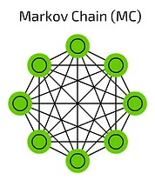
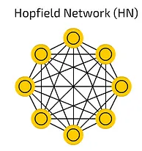
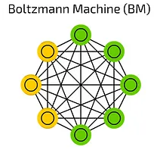
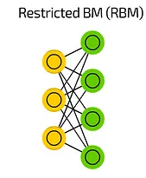
Andrew Tch, “The mostly complete chart of Neural Networks, explained”, Towards Data Science, 4 Aug 2017, url https://towardsdatascience.com/p-3fb6f2367464 [20230411].

Slide 40
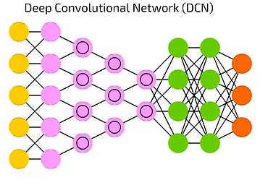
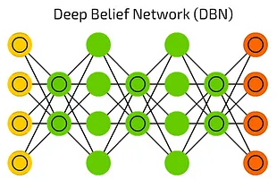
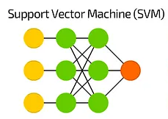



Andrew Tch, “The mostly complete chart of Neural Networks, explained”, Towards Data Science, 4 Aug 2017, url https://towardsdatascience.com/p-3fb6f2367464 [20230411].

Slide 41






Andrew Tch, “The mostly complete chart of Neural Networks, explained”, Towards Data Science, 4 Aug 2017, url https://towardsdatascience.com/p-3fb6f2367464 [20230411].

Slide 42
Thank you
-

